Slide 1

Customer Segmentation: Cluster Analysis
Capstone Project 2
By Rakesh Sethy

Slide 2
Understanding the Data
Project Description:
In the project, a comprehensive EDA was conducted to examine customer behavior and create strategies. Customer, order, campaign and product analyses were conducted. These analyses are critical to better understand the customer base and develop personalized marketing strategies.
About the Project:
Customer Personality Analysis is all about getting to know a company’s ideal customers on a deeper level. By understanding who they are, what they like, and how they behave, businesses can better tailor their products to fit the unique needs of different customer groups.
In this project, we dive into this analysis, helping businesses see beyond the numbers. With these insights, companies can adjust their products and marketing strategies to better connect with specific customer segments. For example, instead of trying to sell a new product to everyone, the company can focus on the group most likely to love it, making their efforts more targeted and effective.

Slide 3


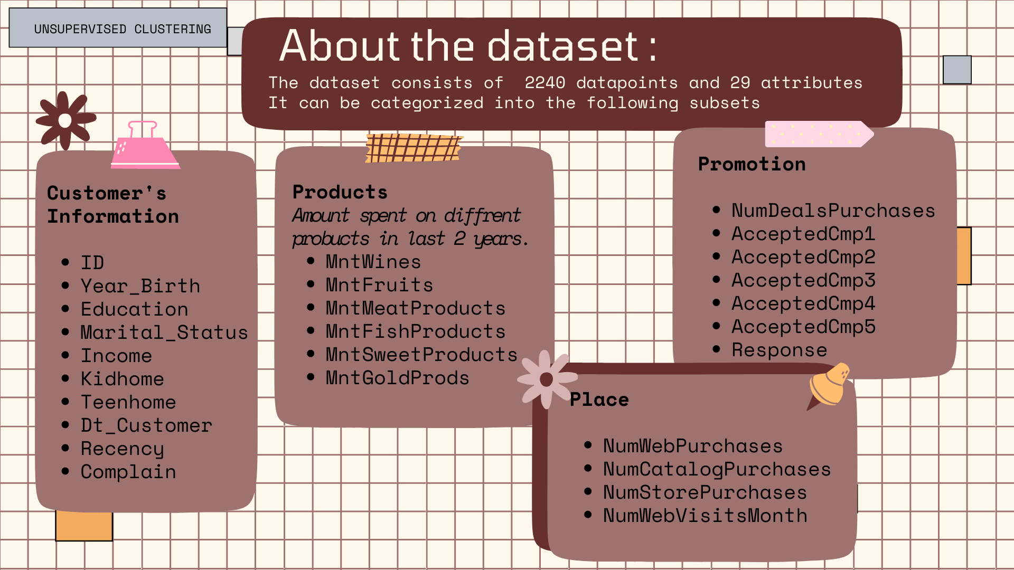
Target:
We need to perform clustering to summarize and understand customer segments. This unsupervised task will help us identify distinct groups within our customer base.
Attributes:

Slide 4
Loading and Understanding Data:
🧮 Observations: The dataset consists of 2,240 observations across 29 columns.
⚠️ Missing Values: 24 missing values are present in the 'income' column.
📊 Column Types: Most columns are numerical, while three are categorical: 'marital_status', 'education', and 'Dt_customer' (which should be converted to a date type).
📈 Outliers: Outliers are present in some numerical columns.
✅ Duplicates: No duplicate records were detected.
Exploratory Data Analysis (EDA):
📉 Outliers: Outliers were identified and removed to improve data quality.
Most of our customers were born between the 60s and the 80s.(Year_Birth)
Most customers have income between 40000 and 80000.(Income)
🔄 Standardization: 'Marital_Status’ was standardized into fewer, broader categories.
We've got two categories that are rather ambiguous, Absurd and YOLO seem to be very little in amount here so we'll drop them.
"Single", "Alone", "Divorced" and "Widow" will be replaced with the value 0
"Together" and "Married" will be replaced with the value 1
And then we create a binary column Relationship with value 0 for no relationship and 1 for relationship.

Slide 5
🔗 Column Consolidation: Some columns were combined to reduce their overall quantity.
Create a new column “offspring” by combining the two columns “Kidhome” and “Teenhome”.
Create a new column “Spending” by the summation of total spending on a specific product.
✂️ Feature Reduction: Unnecessary features were dropped to streamline the dataset.
Dropping the “ID” column as it doesn’t required.
Dropping the unwanted columns “Z_CostContact” and “Z_Revenue”.
Dimensionality Reduction:
In this problem, there are many factors on the basis of which the final classification was done. These factors were basically features. Higher is the features, harder is to work with it. Since, many of these features are correlated, and
hence redundant.
PCA is a dimensionality reduction technique used in statistics and machine learning. It transforms the high dimensional
data into lower dimensional form, capturing the most important information while minimizing the information loss.

Slide 6
Clustering Analysis:
It is a multivariate statistical technique.
It groups the observations based on their features and variables.
In this project, I have used K-means clustering. It is an unsupervised machine learning algorithm. It groups the unlabelled datasets into different clusters.
Brief explanation of clustering with KMeans:
🔴 Initialization: The algorithm starts by randomly selecting a predefined number of cluster centers (centroids).
📍 Assignment: Each data point is then assigned to the nearest centroid, forming initial clusters.
🔄 Update: The centroids are recalculated as the average position of all points within each cluster.
🔁 Iteration: The process of assignment and updating continues until the centroids stabilize and no longer change significantly.
📂 Final Output: The result is a set of clusters where data points in the same cluster are more similar to each other than to those in other clusters.

Slide 7
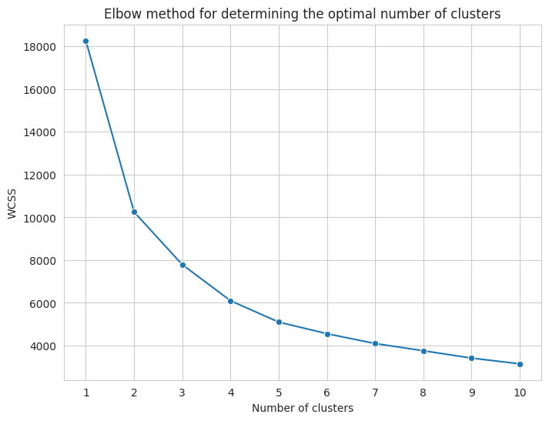
Methods to find values of k(Number of clusters):
As, I have used Elbow method for this project.
It is used to determine the number of clusters to be formed.
I got optimal value k = 4.
So, the important column will be kept for the further analysis
Income
NumDealsPurchases
NumCatalogPurchases
NumStorePurchases
NumWebVisitsMonth
Offspring
Spending
AcceptedCmp1
AcceptedCmp5

Slide 8

Conclusion:-
Cluster analysis revealed four distinct customer segments, each with unique characteristics. The segments are differentiated by their spending habits, income levels, and purchasing behavior.
Segmentation Overview:
Frugal Families (Cluster 0): Low spenders with low income, characterized by fewer store and catalog purchases, frequent visits, and a higher likelihood of having 1-2 kids. They tend to reject campaigns 1 and 5.
Middle-Income Moderates (Cluster 1): Medium-low spenders with medium income, similar to Cluster 0 in terms of purchasing behavior, but with a slightly higher acceptance of campaigns.
High-Rolling Singles (Cluster 2): High spenders with high income, characterized by lower visit frequencies, a higher acceptance of campaigns 1 and 5, and a majority having 0-1 kids.
Aspirational Families (Cluster 3): Medium-high spenders with medium-high income, with purchasing behavior similar to Clusters 0 and 1, but with a lower acceptance of campaigns and a majority having 0 kids.
Thank You

